Slide 1
BIG DATA PROCESSING WITH APACHE SPARK
Dorothy Kucar
Senior Software Engineer, Aliya Financial Technologies

Slide 2
The Course
A typical lecture will consist of “theory” and “practice”(coding or working with technologies we’ll cover)
We will be discussing big data technologies Hadoop, Spark, AWS & Databricks using Scala
You will need to set up an AWS account & Databricks Community Edition account

Slide 3
Who is this course for?
Data scientists who want to learn about Scala, Spark, Databricks & Amazon Web Services
Software engineers who want to explore big data technologies
Others who are just curious about what all these trendy concepts are and are willing to get some hands-on experience

Slide 4
What you need to know
A statically-typed programming language such as Java
Advanced Python knowledge (i.e. object oriented Python) is also okay
SQL: basic queries: SELECT, GROUP BY, ORDER BY
Unix/Linux/OSX: navigating & working with Unix commands
GitHub
Basics of linear algebra for machine learning piece

Slide 5
Goals of this course
Practice using Scala & Spark
Formulating business problem so that you can leverage Scala & Spark
Learn how to use Databricks and Amazon Web Services (AWS)
Networking
Experiences from past students
Past students have upgraded their current jobs
Transitioned into other career areas successfully
Seen an increase in salary

Slide 6
Rough Course Outline
Week-1: Introduction to big data, cloud technologies and Scala
Week-2: OOP and functional programming with Scala
Week-3: Spark architecture (core), Cloud Computing Concepts with Amazon Web Services and Databricks
Week-4: Deep-dive and performance tuning
Week-5: Data analytics with Spark (SQL and Streaming)
Week-6: Machine Learning with Spark (linear, logistic regression, recommender systems, text processing)

Slide 7
Introduction to Big Data
Hadoop and Spark

Slide 8
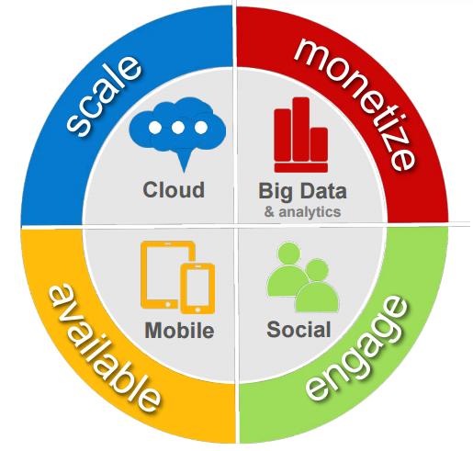
Forces in Digital Era

Slide 9
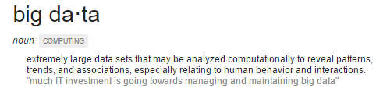
Big Data

Slide 10
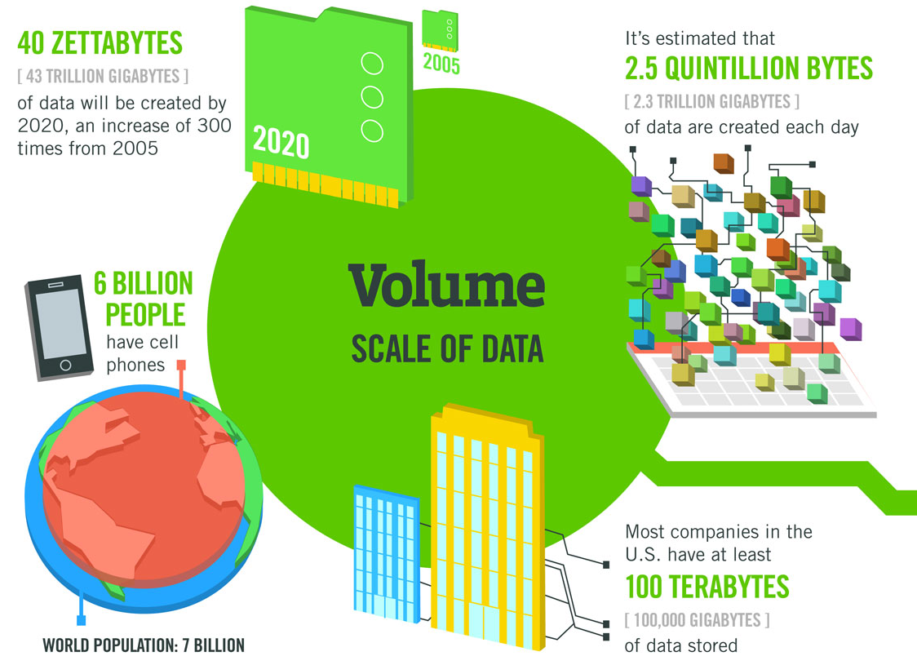
Volume
Source: IBM

Slide 11
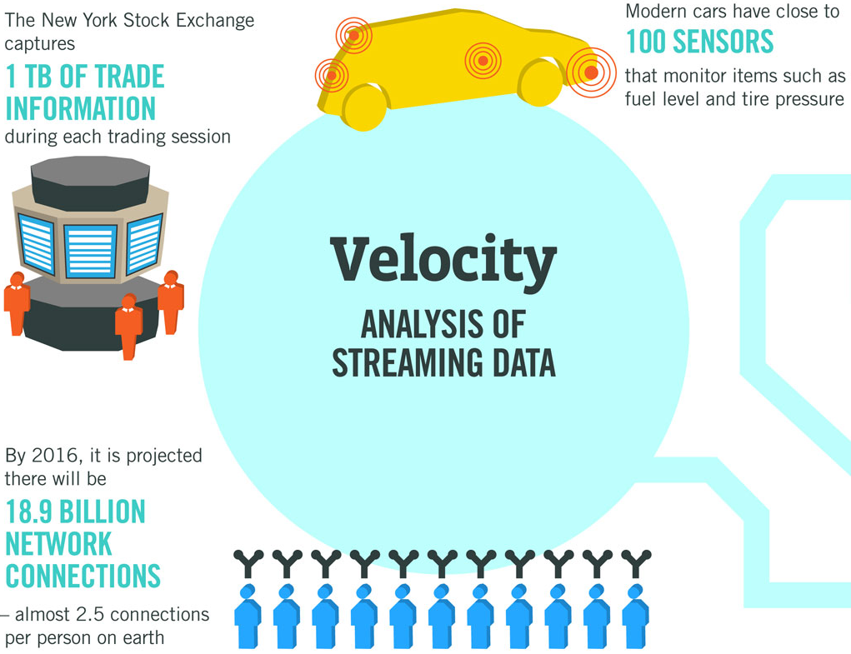
Velocity
Source: IBM

Slide 12
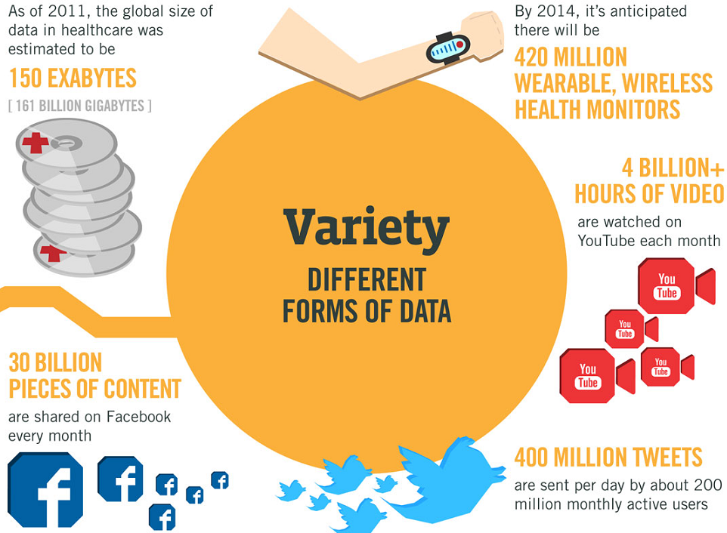
Variety
Source: IBM

Slide 13
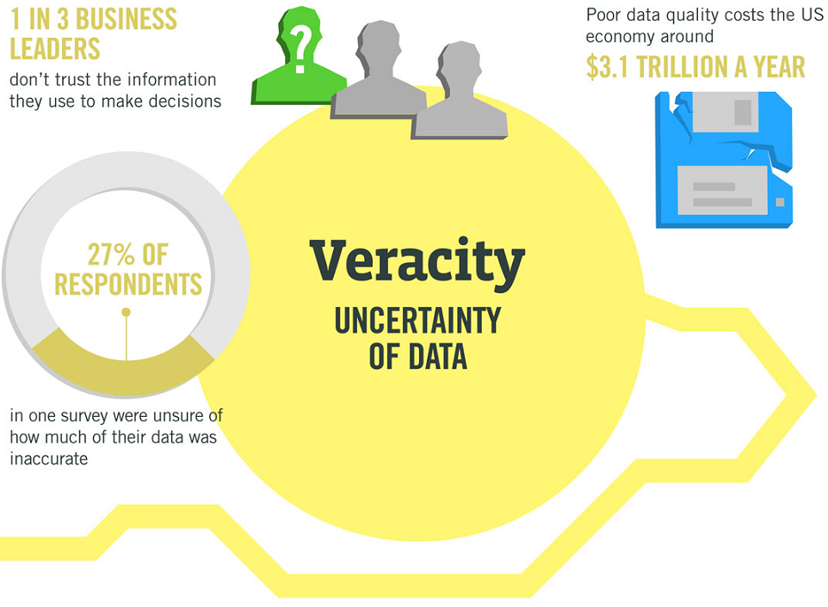
Veracity
Source: IBM

Slide 14
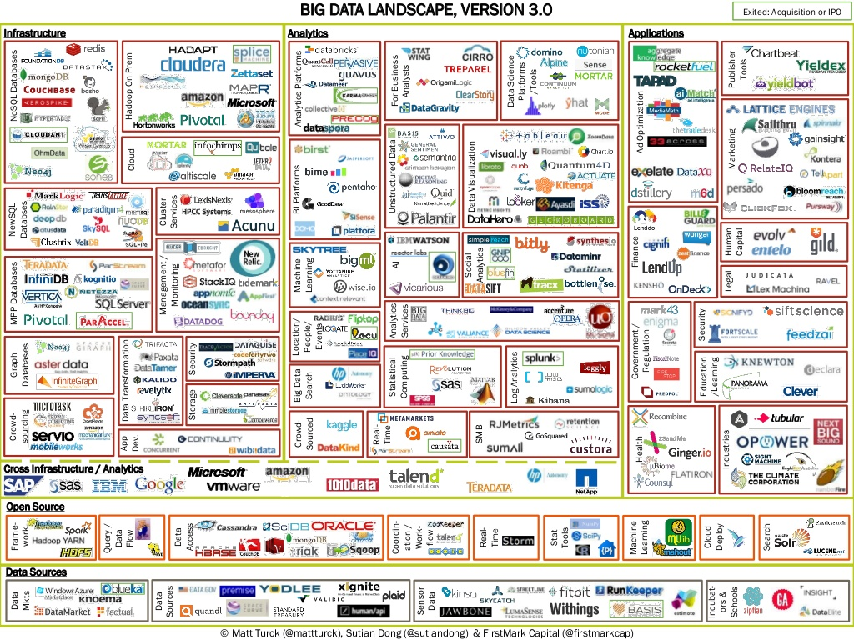
Big Data Ecosystem

Slide 15
Hardware improvements through the years...
CPU Speeds:
1990 - 44 MIPS at 40 MHz
2000 - 3,561 MIPS at 1.2 GHz
2010 - 47,600 MIPS at 3.3 GHz
RAM Memory
1990 - 640K conventional memory (256K extended memory recommended)
2000 - 64MB memory
2010 - 8-32GB (and more)
Disk Capacity and Cost
1990 - 40MB (~$400)
2000 - 10GB (~$175)
2010 - 1TB (~$100)
Disk Latency (speed of reads and writes) – not much improvement in last 7-10 years, currently around 70 – 80MB / sec
Notes:
This chart is to make a point: Scaling up (more powerful computers with power CPUs) is not the answer to all problems since disk latency is the main issue. Scaling out (cluster of computers) is a better approach.

Slide 16
How long it will take to read 1TB of data?
1TB (at 80Mb / sec):
1 disk - 3.4 hours
10 disks - 20 min
100 disks - 2 min
1000 disks - 12 sec
Parallel Data Processing is the answer!
It was with us for a while:
GRID computing - spreads processing load
Distributed workload - hard to manage applications, overhead on developer
Parallel databases – DB2 DPF, Teradata, DB2 PureScale, etc (distribute the data)

Slide 17
Writing Distributed Code
Traditionally, developers have written thread-lock code to handle distributed computing
A lock is a synchronization mechanism for enforcing limits on access to a resource in an environment where there are many threads of execution.
Using thread-lock architectures is complex, time-consuming and error prone
Race conditions: Unsynchronized access to shared memory by threads racing against each other lead to nondeterministic outcome
Deadlock: a thread of a thread pool, is waiting for some other thread to release a lock
A host of other problems
Generally, how to accommodate new/different kinds of hardware as it comes into the data center
Wouldn’t it be nice if a computing paradigm existed that took care of the above issues?

Slide 18
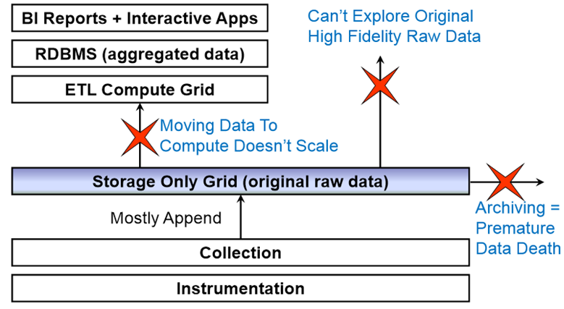
Other Limitations of Traditional Distributed Data Architectures

Slide 19
Distributed File Systems
Hadoop

Slide 20
Data Architectures with Hadoop
Data exploration &
Advanced analytics
BI Reports
RDBMS (Aggregated Data)
Scalable throughput
ETL and aggregation
Hadoop: Storage + Compute Grid
Create and Append
Collection
Instrumentation

Slide 21


What is Apache Hadoop?
Scalable fault tolerant distributed system for data storage and processing
Apache open source software framework
reliable, scalable, distributed computing of massive amount of data
Hides underlying system details and complexities from user
Developed in Java
2 Primary Systems
Hadoop Distributed File System (HDFS)
Self healing high bandwidth clustered storage
MapReduce
Distributed fault tolerant resource management and scheduling
Scalable data programming abstraction
Supported by several Apache related projects
HBase
Zookeeper
Avro
Etc.
Meant for heterogeneous commodity hardware

Slide 22
What is Apache Hadoop?
Flexible, enterprise-class support for processing large volumes of data
Inspired by Google technologies (MapReduce, GFS, BigTable, …)
Initiated at Yahoo
Originally built to address scalability problems of Nutch (open source Web search tool)
Well-suited to batch-oriented, read-intensive applications
Supports wide variety of data
Enables applications to work with thousands of nodes and petabytes of data in a highly parallel, cost effective manner
CPU + disks = “node”
Nodes can be combined into clusters
Data locality (processed where it’s stored)
New nodes can be added as needed without changing
Data formats
How data is loaded
How jobs are written

Slide 23
Design Goals of Hadoop
Ability to store massive data sets
Not just gigabytes, but terabytes, petabytes, and more
Commodity hardware, Data reliability and resilience
No data loss even in the presence of node and infrastructure failures
Horizontal scalability or elasticity
Users must have scalable access to information
Ability to scale on demand
Moving computation is cheaper than moving data
Moving large amounts of data can be extremely inefficient
Reduce remote data transfers, whenever possible
Enable applications to exploit data locality
Notes:
Enabling applications to exploit data locality – via hdfs api to get block locations, and subsequently schedule computation where there data resides

Slide 24
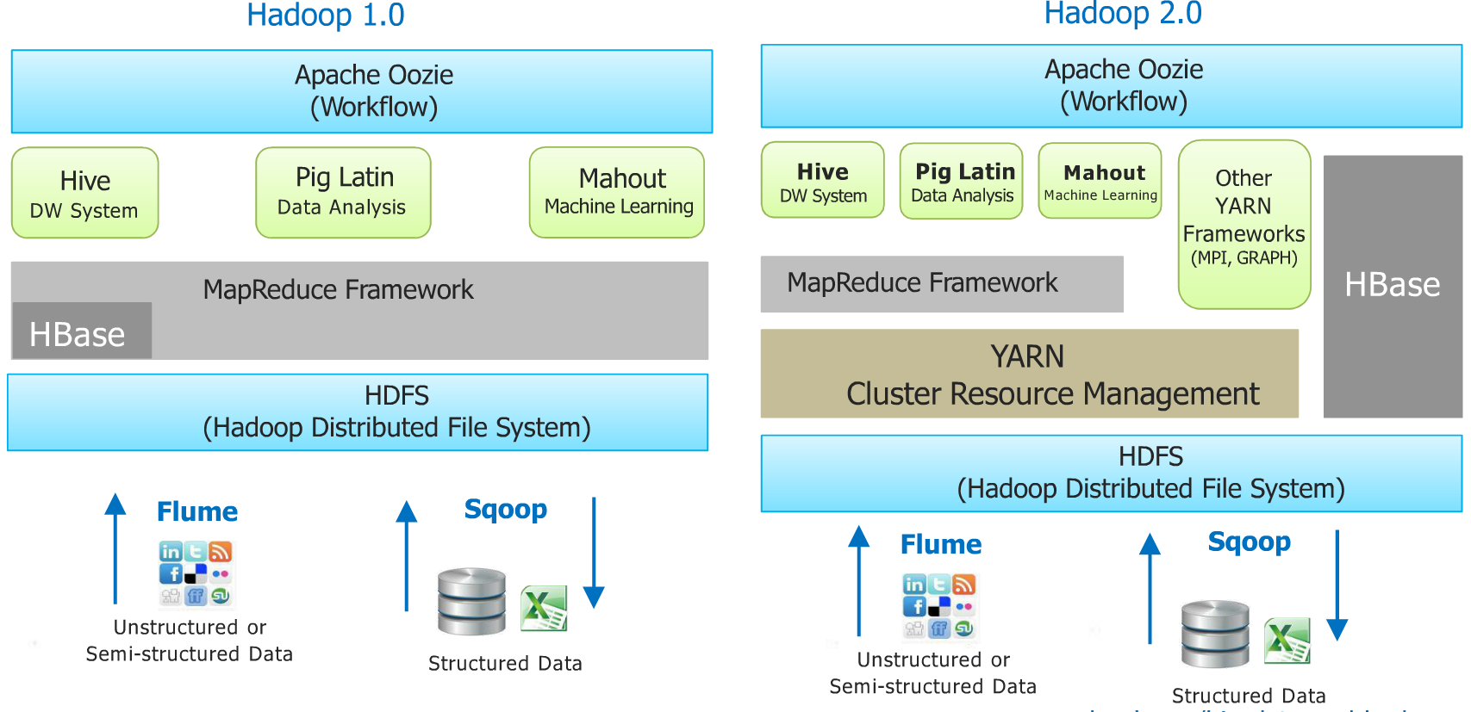
Hadoop Ecosystem

Slide 25
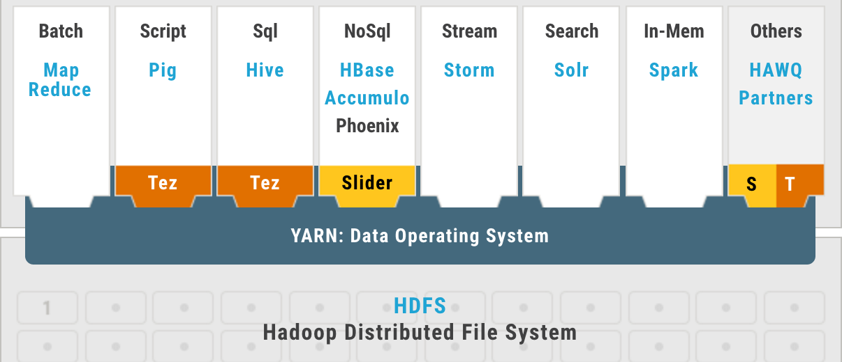
Where does Spark fit in this?
A fast and general engine
for large-scale data processing
with built-in modules for a variety of analytic tasks
Hortonworks Data Platform (HDP ®)

Slide 26
Hadoop vs. RDBMS
Schema-on-Write (RDBMS)
Schema must be defined before any data is loaded
An explicit load operation has to take place which transforms data to internal DB structure
New Columns must be added explicitly before new data for such columns can be loaded into the database
Schema-on-Read (Hadoop)
Data is copied to the file store, no transformation is needed
A SerDe (Serializer/Deserlizer) is applied during read time to extract the required columns (late binding)
New data can start flowing anytime and will appear retroactively once SerDe is updated to parse it.
Read Fast
Standard/Governance
Pros
Load Fast
Flexibility/Agility

Slide 27
Hadoop is not for all workloads!
Not good to process transactions (random access)
Not good when work cannot be parallelized
Not good for low latency data access
Not good for processing lots of small files
Not good for intensive calculations with little data
Must code all applications in terms of map and reduce steps

Slide 28
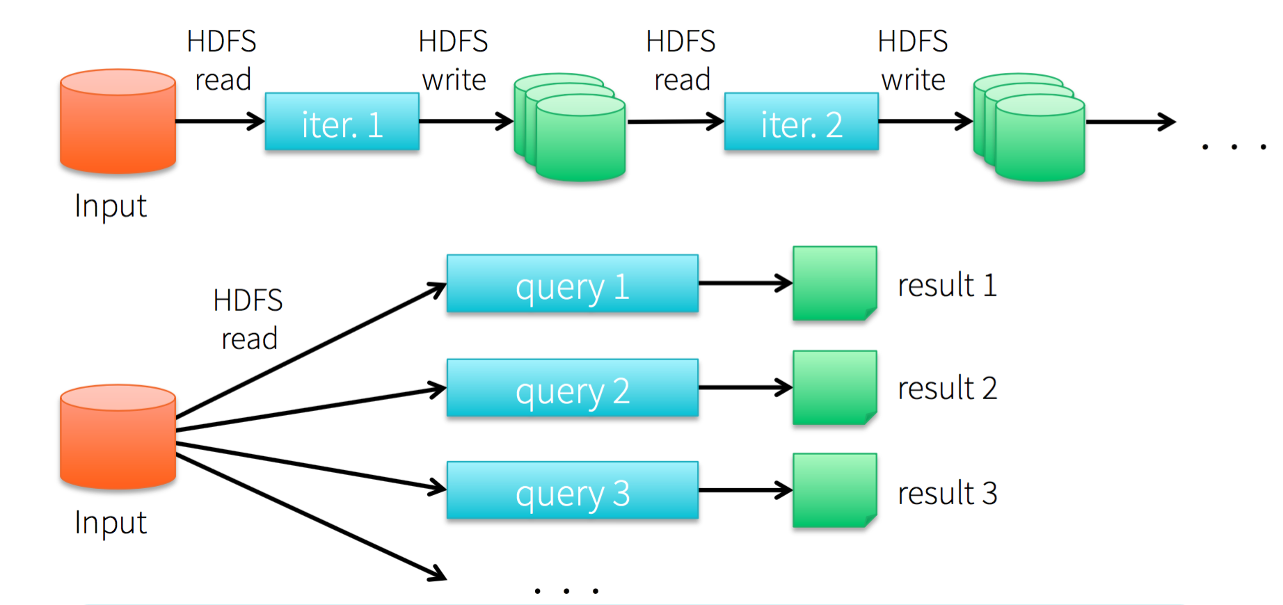
Data Processing in Hadoop
Step 1
Step 2
Poor performance due to repeated disk I/O and replication

Slide 29
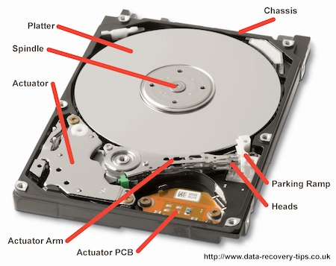
Hard Disk Drive

Slide 30
Hard disk seek time
Time taken for hard disk controller to locate a specific piece of stored data
When anything is written/read to disc drive, the r/w head of disk needs to move to right position
Try to minimize # disk reads, writes
This is the limiting factor to accessing data
Video of How a Hard Disk Works

Slide 31

Exercise
Why do we need distributed computing?
Why do we need Hadoop?
What is commodity hardware?
What are some of the disadvantages of Hadoop?
How are Relational Database Management Systems (RDBMS) different from Hadoop?

Slide 32
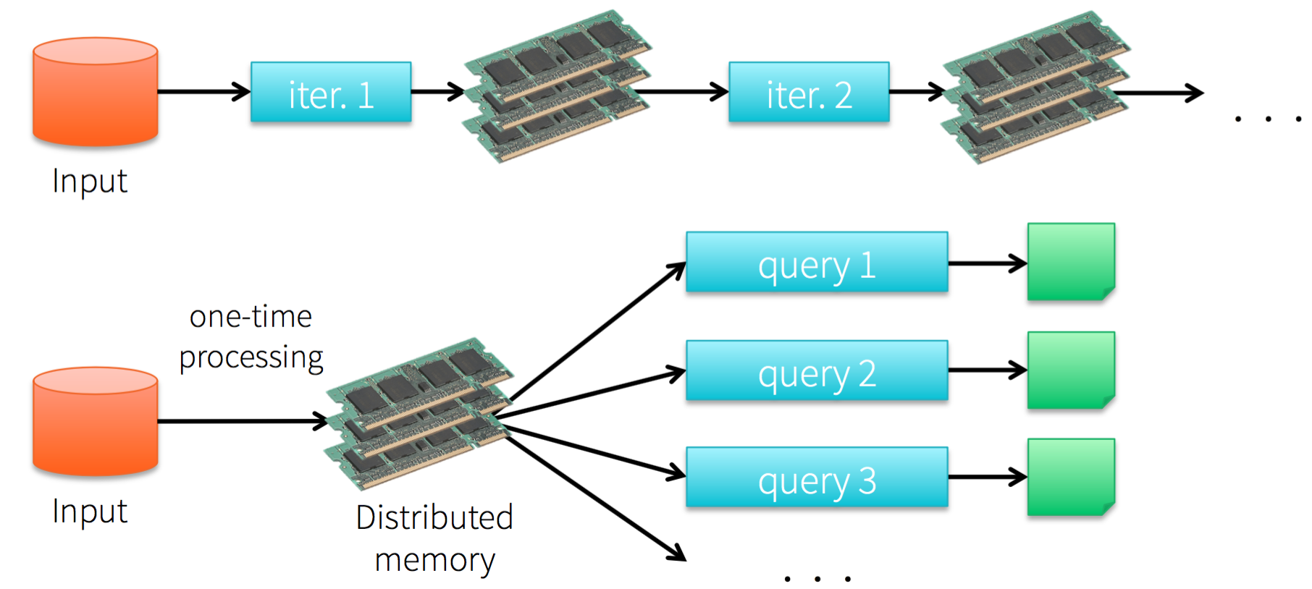
Data Processing in Spark
Improvement on Hadoop: use memory instead of hard disk
Step 1
Step

Slide 33
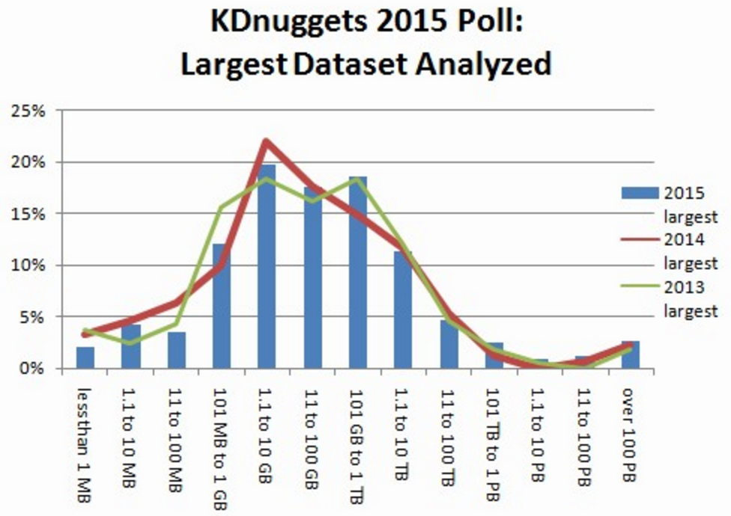
Data Processing in Spark
Exploit memory whenever possible

Slide 34
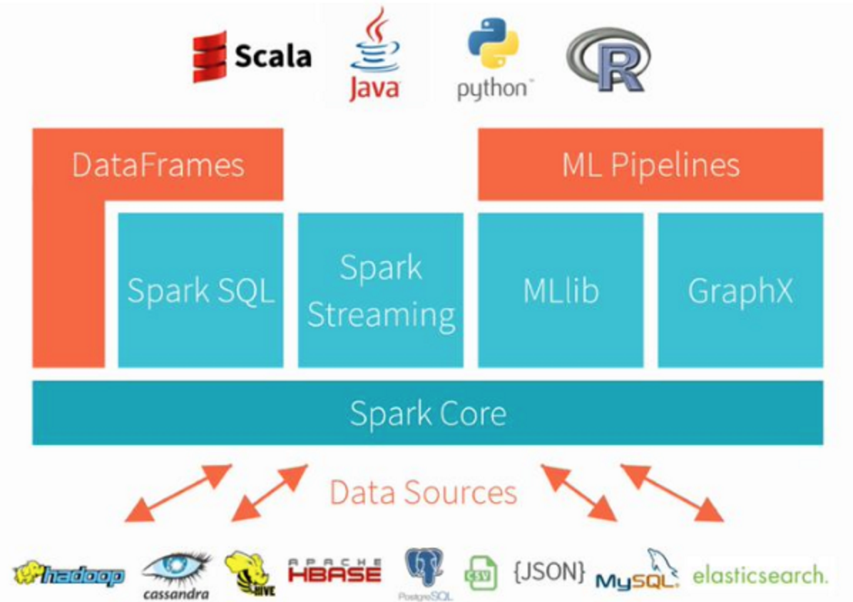
Spark Stack
All are compute components …
By design, it does not include a file system! This is why we will introduce Hadoop Distributed File System

Slide 35
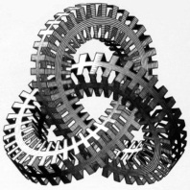
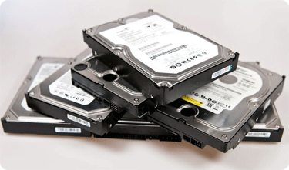

Hadoop Distributed File System (HDFS)
Design Point:
Store very large files with streaming data access patterns, running on clusters of commodity hardware
Fault-tolerance:
No data loss, no service interruptions!
Gigabytes, Terabytes, and Petabytes
Most common access pattern: write-once, read-many-times
For each analysis, read entire or majority of the data set
➔ Time to read entire data set is more important than time to read the first record!

Slide 36
HDFS Basics
Master-slave architecture
Master = Name node; Slaves = Data nodes
Block-structured file system
Like most other file systems, however w/ larger block size
Blocking: Configurable block size (64 MB default)
Block distribution: Distribution of blocks across different nodes (data nodes!)
Replication: Each data block is stored on multiple data nodes
B1 | B2 | B3 | B4
File
Blocks of equal size
Data partitioning & block distribution is done by the system
…
Data Nodes

Slide 37

Blocking
Very popular concept
Files are split into equal-sized blocks
Blocks are stored as independent units
Nodes storing data blocks are known as data nodes
Block size
Common size in most file systems: 4-8 KB
HDFS default block size = 128 MB
In practice, greater than 128MB is also common
Favors streaming scans as large amounts of data is laid out sequentially on disk
Configurable at file-level
Notes:
Few very large files vs. many small files
Sequential vs. random accesses
Both these points can come in highlights
Larger blocks -> less seeks, seek to the beginning of each block and read the block sequentially
HDFS files are managed by data nodes, and hence users must not manipulate block files via Linux

Slide 38
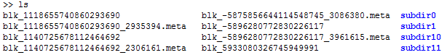
Blocking
HDFS runs in its own separate namespace
HDFS Files are not seen as part of ordinary FS
Blocks are stored as individual files, w/ some internal names
Users should not interact and manipulate these block files via ordinary Linux FS tools (cp, mv, etc.), as they are managed by data nodes!
350MB files is split into 3 blocks of size 128MB, 128MB, 94MB
A file smaller than HDFS block size does not occupy full block’s worth of storage!
Notes:
Few very large files vs. many small files
Sequential vs. random accesses
Both these points can come in highlights
Larger blocks -> less seeks, seek to the beginning of each block and read the block sequentially
HDFS files are managed by data nodes, and hence users must not manipulate block files via Linux

Slide 39
Why Large Block Size?
HDFS is designed for streaming access over data residing on commodity hardware
Minimize the time spent in disk seeks
Focus on high throughput of data access rather than low-latency of data access
Example:
Seek time = 10ms, transfer rate = 100 MB/s
Reading 100MB block
Seek time (10ms) is 1% of transfer time (1sec)
Reading 64KB block
Seek time (10ms) is >10 times of transfer time (0.625ms)
Larger block size, the smaller is the effect of seek time!
As transfer speeds grow w/ new generation of disk drives, block size must be increased!

Slide 40
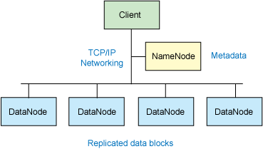
Master-Slave Architecture
Master: Namenode
Manages file system namespace
Maintains file system tree and metadata
Typical operations
Open, close, rename files
Slaves: Datanodes
Workhorses!
Store and retrieve data blocks
When they are told by the client or the namenode
Report back to namenode periodically with the list of blocks they store
Typical operations
Block creation, deletion, and replication
Without the namenode, file system can not be used !

Slide 41

Namenode
Metadata consists of
List of files (tree)
List of blocks for each file
List of data nodes for each block
Replication factor
Other file-level attributes, such as owner, permissions, access timings
Edit log
Metadata is stored in memory
Protect against data loss
Store metadata persistently on the disk (with backup)
Run a secondary namenode
Run a hot standby namenode
Each directory, file, and block takes 150 Bytes of metadata

Slide 42
Block Distribution & Replication
Example: a 6-node cluster
Name node must be a high-end server w/ RAID
Name Node
(metadata store)
/usr/john/foo.txt
A1
A2
conf/hadoop-site.xml
dfs.replication = 3
/usr/john/bar.txt
B1
B2
B3
No Data Loss!!
Node Crash!!
B1
A2
A1
B2
B1
B2
B1
B3
A1
B2
B3
B3
A2
A1
A2
Data Nodes

Slide 43

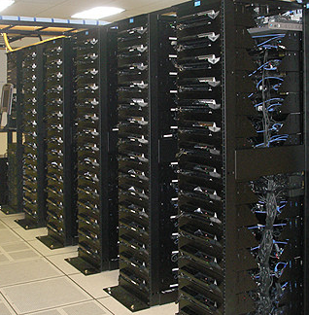
Typical Data Center (Hadoop cluster)
Rack 1
Rack 2
Rack m
Node 1
Node 2
Node 3
…
Node 4
…
…
…
Node n

Slide 44
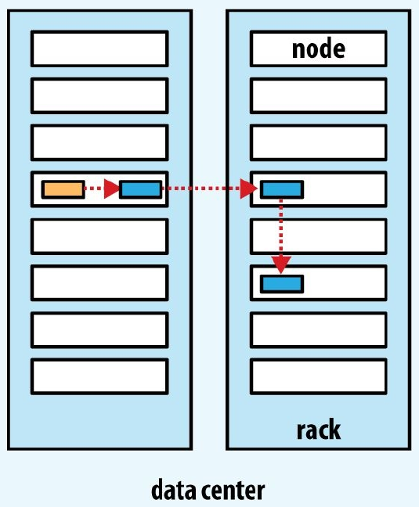
Replica Placement – Rack Awareness
Tradeoff between reliability and read/write bandwidth
First copy
On the client that generated the data
If the client is outside cluster, then choose a node randomly
Second copy
On any node from a different rack
Third copy
On the same rack as that of second copy
But on a different node than that of second copy

Slide 45
When NOT to use HDFS?
Random accesses over data (read/write)
Suited more for long streaming sequential scans over data
Data updates
Limited support for appends
Large number of small files
Increases metadata overhead @ namenode
Loss of performance
Since it is designed for streaming, data is not cached locally i.e., it is always read from HDFS
Performance degrades proportionally w/ node failures
No transaction support
Restricted consistency models
Notes:
Write once, read multiple times

Slide 46
Exercise
How does Spark fit into the Hadoop Stack?
Does Spark come with its own distributed file system?
How might one access Spark in a cloud computing context?

Slide 47
References
Introduction to Hadoop
https://www.tutorialspoint.com/hadoop/hadoop_introduction.htm
“Hadoop: The Definitive Guide” by Tom White, O’Reilly
https://www.iteblog.com/downloads/OReilly.Hadoop.The.Definitive.Guide.4th.Edition.2015.3.pdf
To set up ssh putty on windows, follow the instructions on
http://docs.aws.amazon.com/AWSEC2/latest/UserGuide/putty.html
To get an aws terminal with hadoop, follow instructions
http://docs.aws.amazon.com/ElasticMapReduce/latest/DeveloperGuide/emr-connect-master-node-ssh.html

Slide 48
Extra

Slide 49
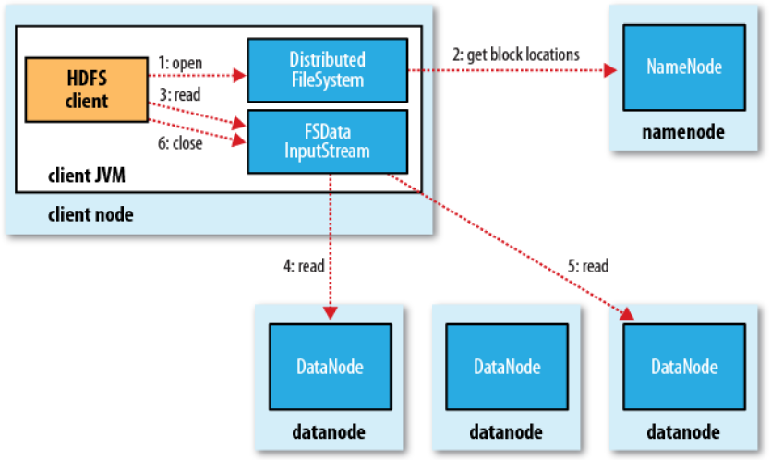
Architecture – Anatomy of File Read
Transparent to client
Wraper on DFSInputStream, which manages datanode and namenode I/O
Client contacts data nodes directly, thereby providing scalability!
Notes:
Scalability: no namenode pressure (no single point bottleneck), and ability to serve large number of clients conccurrently!

Slide 50
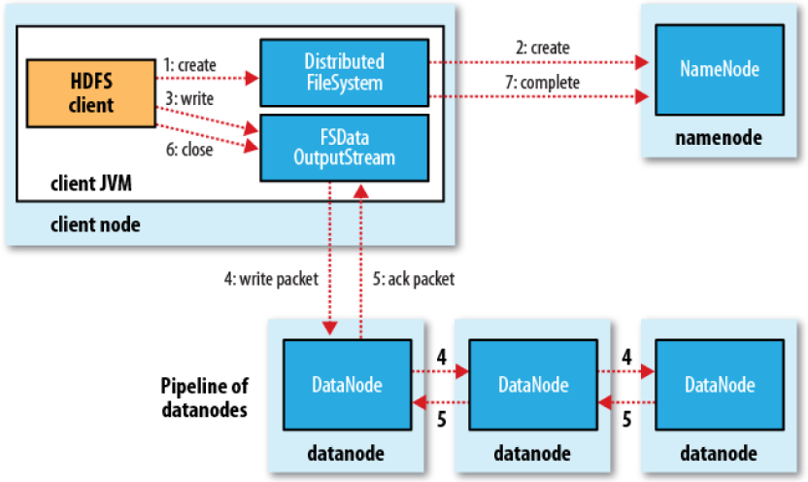
Architecture – Anatomy of File Write
Transparent to client
Replication

Slide 51
HDFS Setup
Configuration properties in conf/hadoop-site.xml
URI for namenode, used by all data nodes in all their interactions w/ namenode
Data directory
Metadata directory
Data and name node directories
Start and stop scripts
bin/start-hdfs.sh, bin/stop-hdfs.sh
<configuration>
<property>
<name>fs.default.name</name>
<value>
dfs://your.server.name.com:9000
</value>
</property>
<property>
<name>dfs.data.dir</name>
<value>/home/username/hdfs/data</value>
</property>
<property>
<name>dfs.name.dir</name>
<value>/home/username/hdfs/name</value>
</property>
</configuration>

Slide 52
Summary of HDFS commands
hdfs dfs –cat <URI>
hdfs dfs –chmod [-R] <MODE>
hdfs dfs –cp URI <dest>
hdfs dfs –get <src> <local>
hdfs dfs –ls <args>
hdfs dfs –mv URI <dest>
hdfs dfs –put <local> <dest>
hdfs dfs –tail URI
Copy source path to stdout
Change permissions of files
Copy files within HDFS
Copy files from HDFS to local
File listing
Move files within HDFS
Copy files from local to HDFS
Display last KB of file to stdout

